Slide 1

Digital Twin

Slide 2
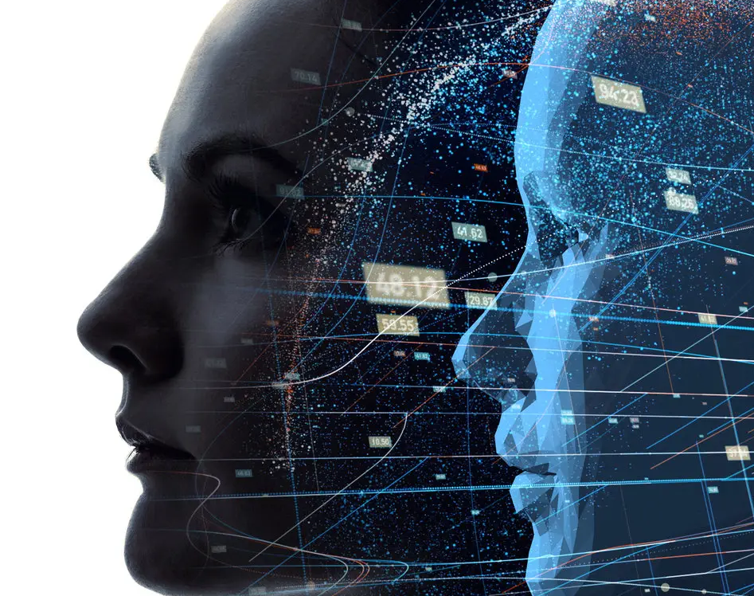
What is Digital Twin?

Slide 3
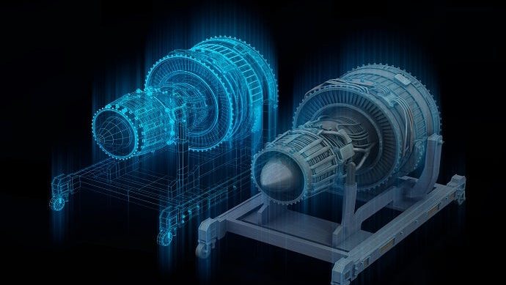
Real time entity/process
Virtual representation
Data that connects the two

Slide 4

Types of Digital twins?
Component twins
Process twins
Asset twins
System twins

Slide 5

How does a digital twin work?

Slide 6

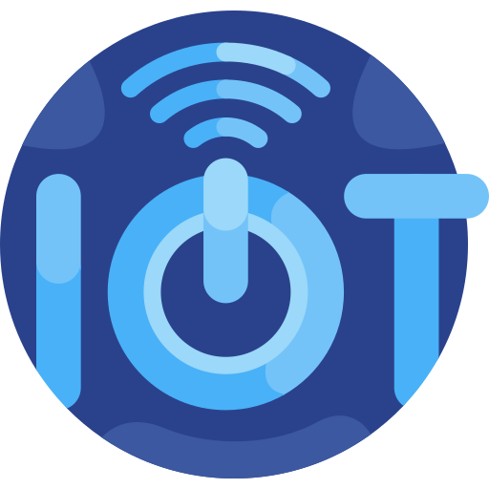
IOT
Artificial Intelligence

Slide 7






DATA COLLECTION
REAL-TIME
MONITORING
MODEL CREATION
FEEDBACK
LOOP
ANALYSIS AND SIMULATION
WORKING OF DIGITAL TWIN
DATA INTEGRATION
This Photo by Unknown Author is licensed under CC BY-SA-NC

